Slide 4
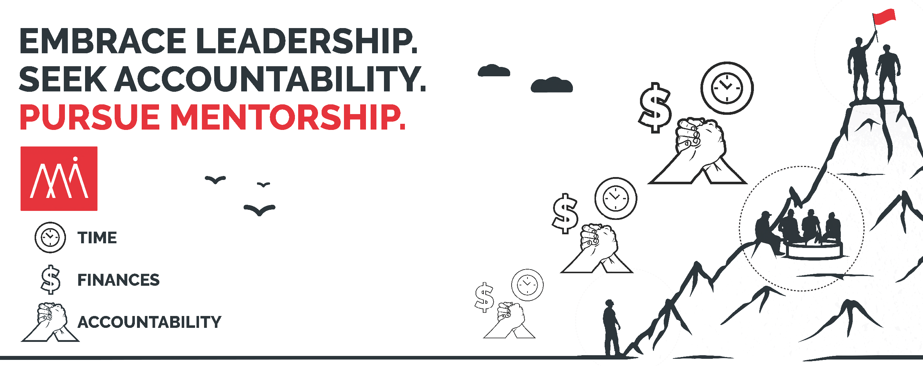

Slide 5
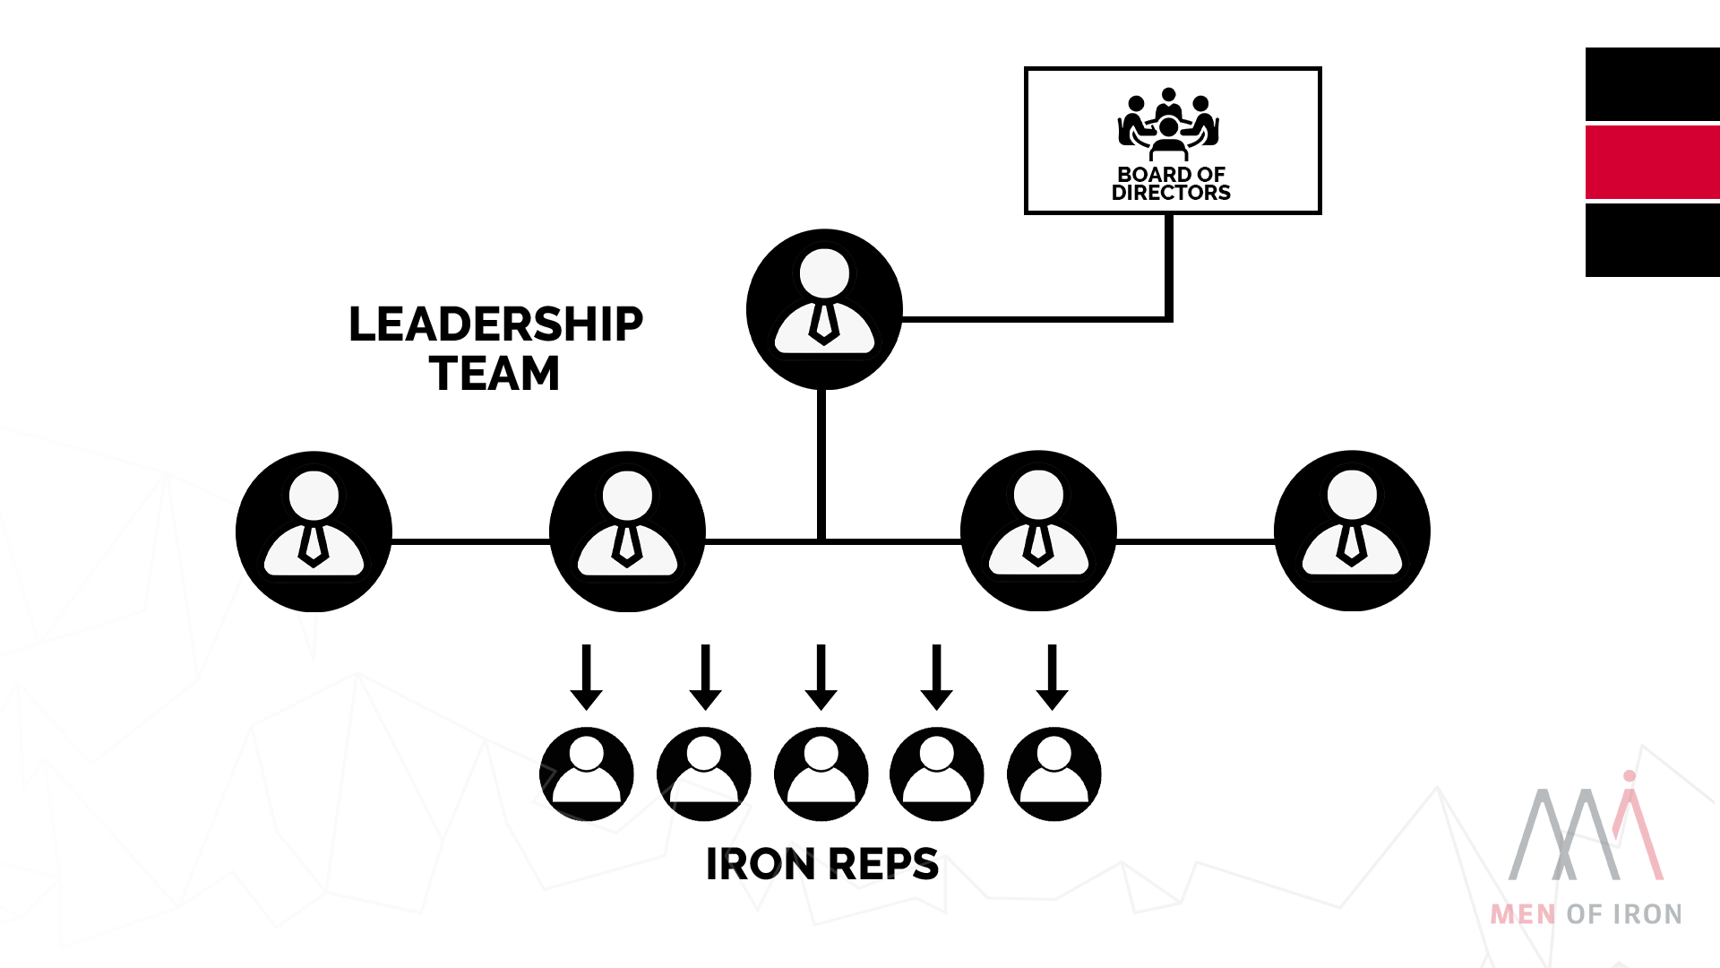

Slide 7
Structure & Strategy
Board of Directors
Leadership Team
Iron Table
Iron Rep
(Network & Influence)
LOCAL IMPACT
(Execution of Plan)

